Slide 1
Lecture-33
Mathematics 2 (15B11MA211)
CO [C106.5]
Topic: Taylor’s Series Expansion
Reference for the lecture
R.K Jain and S.R.K. Iyenger, “Advanced Engineering Mathematics” fifth edition, Narosa publishing house, 2016.

Slide 2
Topics Covered
Taylor’s Series
Proof of Taylor’s theorem
Examples

Slide 3
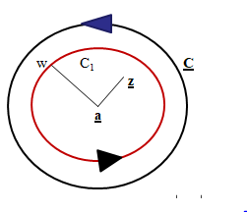
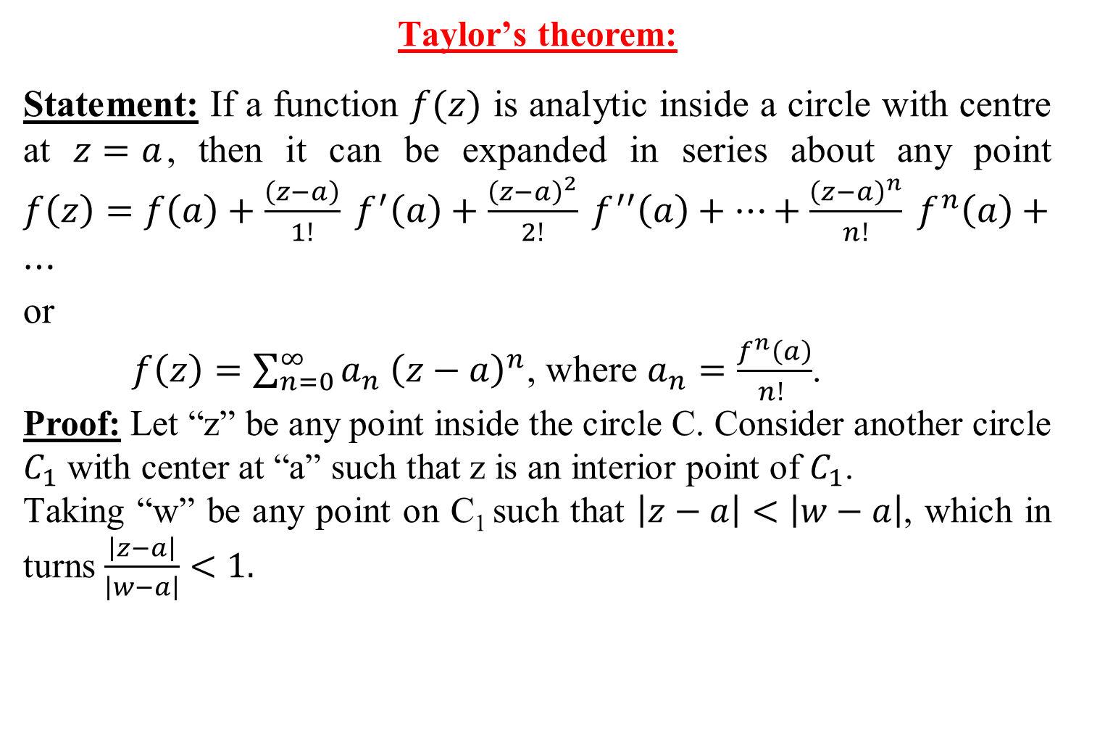
Taylor’s theorem:
Statement: If a function $f(z)$ is analytic inside a circle with centre at $z=a$, then it can be expanded in series about any point $f\left(z\right)=f\left(a\right)+\frac{\left(z−a\right)}{1!} f^{′}\left(a\right)+\frac{{\left(z−a\right)}^{2}}{2!} f^{′′}\left(a\right)+⋯+\frac{{\left(z−a\right)}^{n}}{n!} f^{n}\left(a\right)+⋯$
or
$f\left(z\right)=\sum_{n=0}^{∞}{a_{n} {\left(z−a\right)}^{n}}$, where $a_{n}=\frac{f^{n}\left(a\right)}{n! }$.
Proof: Let “z” be any point inside the circle C. Consider another circle $C_{1}$ with center at “a” such that z is an interior point of $C_{1}$.
Taking “w” be any point on C₁ such that $\left|z−a\right|<\left|w−a\right|$, which in turns $\frac{\left|z−a\right|}{\left|w−a\right|}<1.$

Slide 4
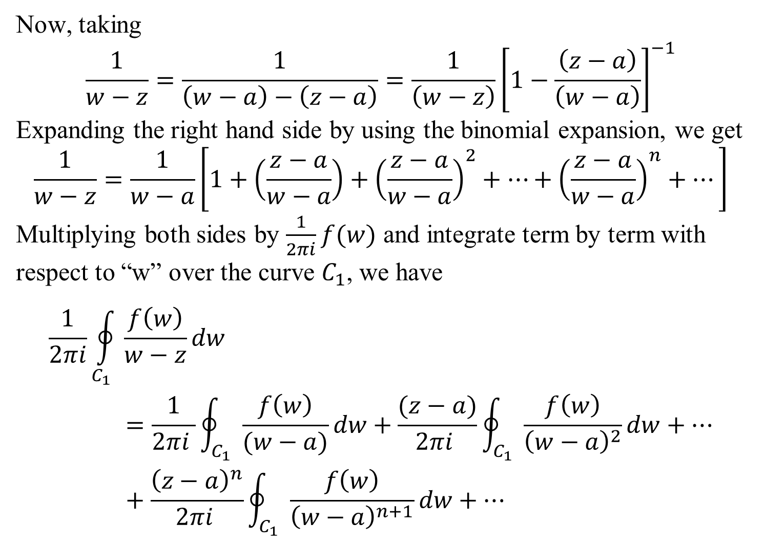
Now, taking
$$\frac{1}{w−z}=\frac{1}{\left(w−a\right)−\left(z−a\right)}=\frac{1}{\left(w−z\right)}{\left[1−\frac{\left(z−a\right)}{\left(w−a\right)}\right]}^{−1}$$
Expanding the right hand side by using the binomial expansion, we get
$$\frac{1}{w−z}=\frac{1}{w−a}\left[1+\left(\frac{z−a}{w−a}\right)+{\left(\frac{z−a}{w−a}\right)}^{2}+⋯+{\left(\frac{z−a}{w−a}\right)}^{n}+⋯\right]$$
Multiplying both sides by $\frac{1}{2πi}f(w)$ and integrate term by term with respect to “w” over the curve $C_{1}$, we have
$$\frac{1}{2πi}\oint_{C_{1}}{\frac{f\left(w\right)}{w−z}dw}=\frac{1}{2πi }\oint_{C_{1}}{\frac{f\left(w\right)}{(w−a)}dw}+\frac{(z−a)}{2πi }\oint_{C_{1}}{\frac{f\left(w\right)}{{\left(w−a\right)}^{2}}dw}+⋯+\frac{{\left(z−a\right)}^{n}}{2πi }\oint_{C_{1}}{\frac{f\left(w\right)}{{\left(w−a\right)}^{n+1}}dw}+⋯$$

Slide 5
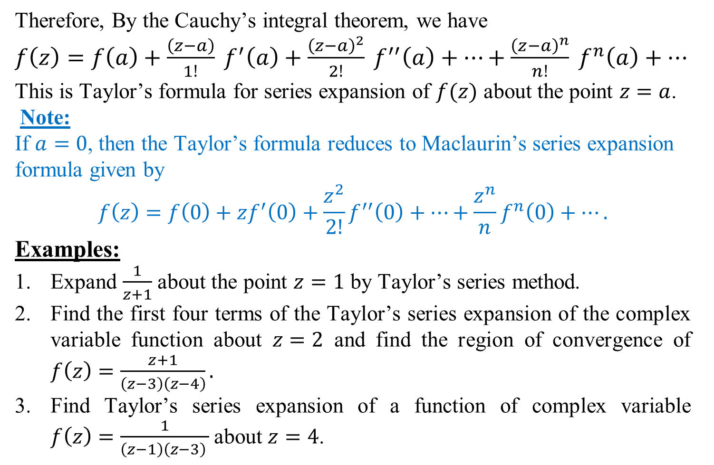
Therefore, By the Cauchy’s integral theorem, we have
$f\left(z\right)=f\left(a\right)+\frac{\left(z−a\right)}{1!} f^{′}\left(a\right)+\frac{{\left(z−a\right)}^{2}}{2!} f^{′′}\left(a\right)+⋯+\frac{{\left(z−a\right)}^{n}}{n!} f^{n}\left(a\right)+⋯$
This is Taylor’s formula for series expansion of $f(z)$ about the point $z=a$.
Note:
If $a=0$, then the Taylor’s formula reduces to Maclaurin’s series expansion formula given by
$$f\left(z\right)=f\left(0\right)+zf^{′}\left(0\right)+\frac{z^{2}}{2!}f^{′′}\left(0\right)+⋯+\frac{z^{n}}{n}f^{n}\left(0\right)+⋯.$$
Examples:
Expand $\frac{1}{z+1}$ about the point $z=1$ by Taylor’s series method.
Find the first four terms of the Taylor’s series expansion of the complex variable function about $z=2$ and find the region of convergence of $f\left(z\right)=\frac{z+1}{\left(z−3\right)\left(z−4\right)}.$
Find Taylor’s series expansion of a function of complex variable $f\left(z\right)=\frac{1}{\left(z−1\right)\left(z−3\right) }$about $z=4$.

Slide 6
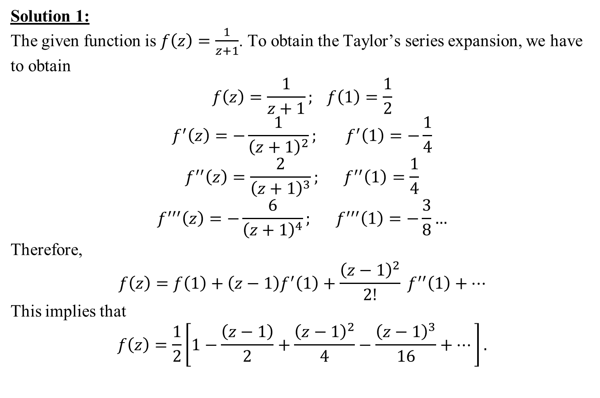
Solution 1:
The given function is $f\left(z\right)=\frac{1}{z+1}$. To obtain the Taylor’s series expansion, we have to obtain
$$f\left(z\right)=\frac{1}{z+1}; f\left(1\right)=\frac{1}{2}$$
$$f^{′}\left(z\right)=−\frac{1}{{\left(z+1\right)}^{2}}; f^{′}\left(1\right)=−\frac{1}{4}$$
$$f^{′′}\left(z\right)=\frac{2}{{\left(z+1\right)}^{3}}; f^{′′}\left(1\right)=\frac{1}{4}$$
$$f^{′′′}\left(z\right)=−\frac{6}{{\left(z+1\right)}^{4}}; f^{′′′}\left(1\right)=−\frac{3}{8}…$$
Therefore,
$$f\left(z\right)=f\left(1\right)+\left(z−1\right)f^{′}\left(1\right)+\frac{{\left(z−1\right)}^{2}}{2!} f^{′′}\left(1\right)+⋯$$
This implies that
$$f\left(z\right)=\frac{1}{2}\left[1−\frac{\left(z−1\right)}{2}+\frac{{\left(z−1\right)}^{2}}{4}−\frac{{\left(z−1\right)}^{3}}{16}+⋯\right].$$

Slide 7
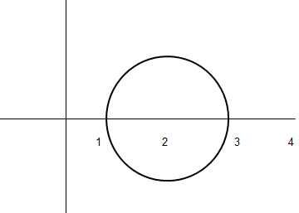
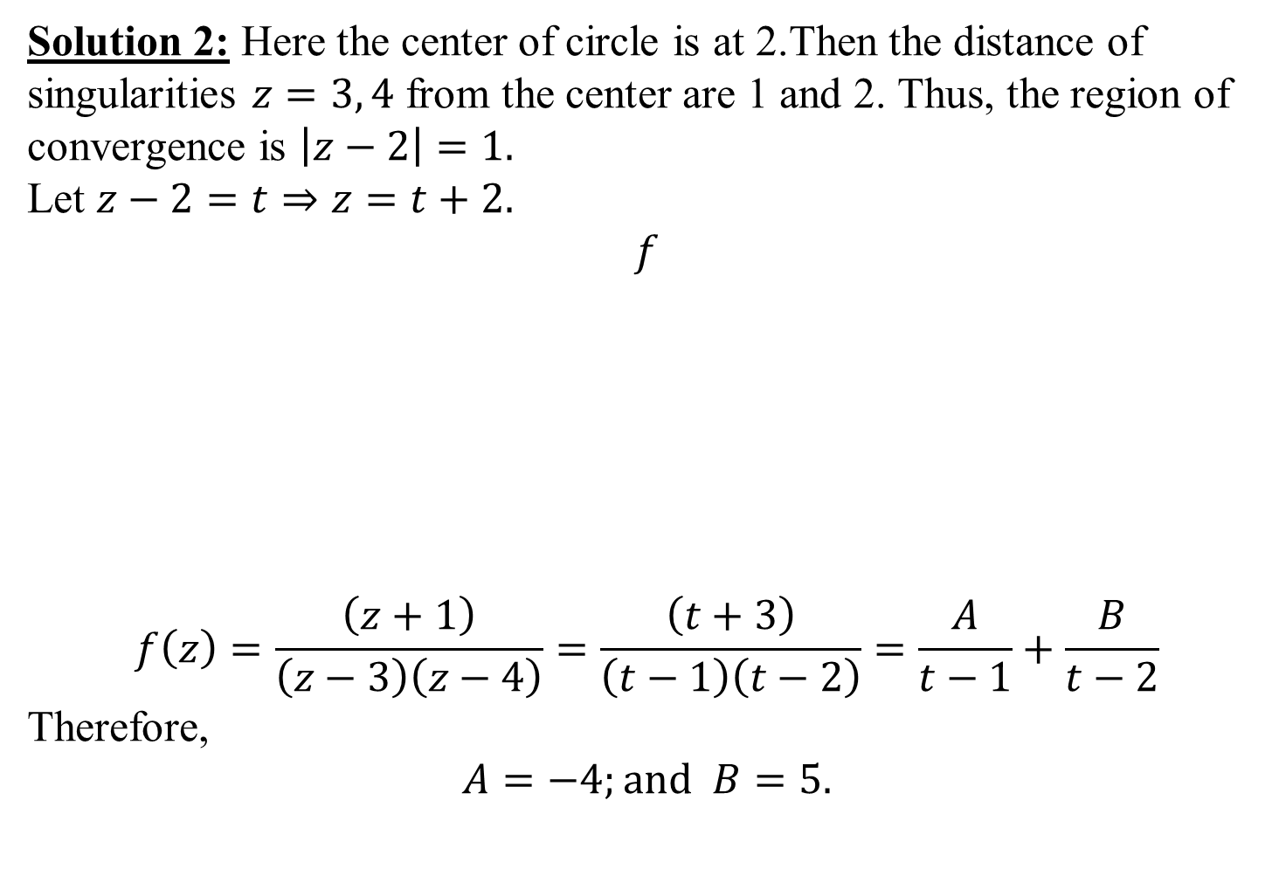
Solution 2: Here the center of circle is at 2.Then the distance of singularities $z=3, 4$ from the center are 1 and 2. Thus, the region of convergence is $\left|z−2\right|=1.$
Let $z−2=t⇒z=t+2.$
$$f$$
$$f\left(z\right)=\frac{\left(z+1\right)}{\left(z−3\right)\left(z−4\right)}=\frac{\left(t+3\right)}{\left(t−1\right)\left(t−2\right)}=\frac{A}{t−1}+\frac{B}{t−2}$$
Therefore,
$$A=−4;and B=5.$$

Slide 8
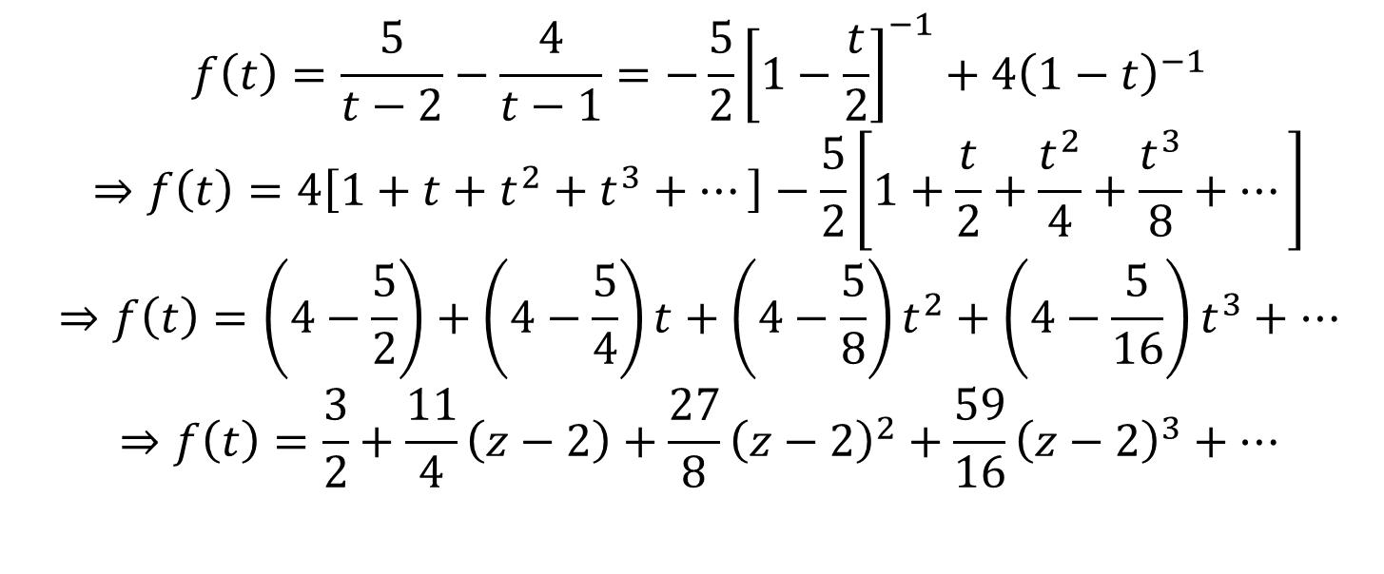
$$f\left(t\right)=\frac{5}{t−2}−\frac{4}{t−1}=−\frac{5}{2}{\left[1−\frac{t}{2}\right]}^{−1}+4{\left(1−t\right)}^{−1}$$
$$⇒f\left(t\right)=4\left[1+t+t^{2}+t^{3}+⋯\right]−\frac{5}{2}\left[1+\frac{t}{2}+\frac{t^{2}}{4}+\frac{t^{3}}{8}+⋯\right]$$
$$⇒f\left(t\right)=\left(4−\frac{5}{2}\right)+\left(4−\frac{5}{4}\right)t+\left(4−\frac{5}{8}\right)t^{2}+\left(4−\frac{5}{16}\right)t^{3}+⋯$$
$$⇒f\left(t\right)=\frac{3}{2}+\frac{11}{4}\left(z−2\right)+\frac{27}{8}{\left(z−2\right)}^{2}+\frac{59}{16}{\left(z−2\right)}^{3}+⋯$$

Slide 9
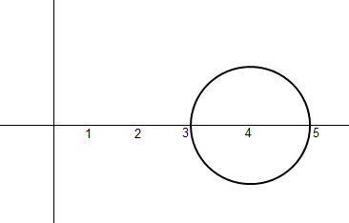
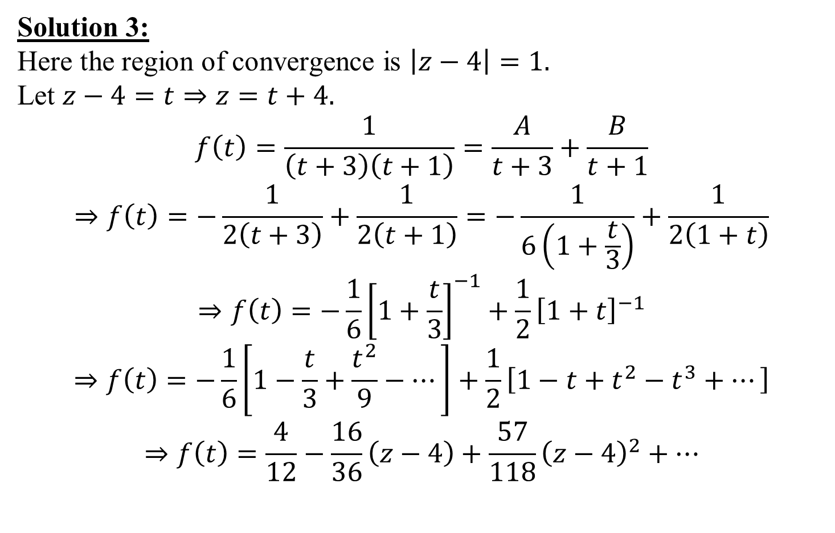
Solution 3:
Here the region of convergence is $\left|z−4\right|=1.$
Let $z−4=t⇒z=t+4.$
$$f\left(t\right)=\frac{1}{\left(t+3\right)\left(t+1\right)}=\frac{A}{t+3}+\frac{B}{t+1}$$
$$⇒f\left(t\right)=−\frac{1}{2\left(t+3\right)}+\frac{1}{2\left(t+1\right)}=−\frac{1}{6\left(1+\frac{t}{3}\right)}+\frac{1}{2\left(1+t\right)}$$
$$⇒f\left(t\right)=−\frac{1}{6}{\left[1+\frac{t}{3}\right]}^{−1}+\frac{1}{2}{\left[1+t\right]}^{−1}$$
$$⇒f\left(t\right)=−\frac{1}{6}\left[1−\frac{t}{3}+\frac{t^{2}}{9}−⋯\right]+\frac{1}{2}\left[1−t+t^{2}−t^{3}+⋯\right]$$
$$⇒f\left(t\right)=\frac{4}{12}−\frac{16}{36}\left(z−4\right)+\frac{57}{118}{\left(z−4\right)}^{2}+⋯$$

Slide 10
THANK YOU

